Slide 1
Programming with Python
MSc. Ivan A. Escobar Broitman
iescobar@itesm.mx
http://iescobar.com

Slide 2
Outline
Why should we use Python?
How to start the interpreter on a Mac?
Working with Strings.
Receiving parameters from the command line.
Receiving input from the user.
Importing libraries.
Working with math.

Slide 3
Why Python?
Python is
  easy to learn,
  relatively fast,
  object-oriented,
  strongly typed,
  widely used, and
  portable.
C is much faster but much harder to use.
Java is about as fast and slightly harder to use.
Perl is slower, is as easy to use, but is not strongly typed.

Slide 4
Getting started on the Mac
Start a terminal session.
Type “python”
This should start the Python interpreter
> python
Python 2.4.2 (#2, Apr 10 2006, 16:28:28)
[GCC 3.2.3 20030502 (Red Hat Linux 3.2.3-53)] on linux2
Type "help", "copyright", "credits" or "license" for more information.
>>> print “hello, world!”
hello, world!

Slide 5
Working with Strings
A string in python has a type str . It consists of a collection of characters in a sequence (the order does matter), delimited by single quotes (‘ ‘) or by double quotes (“ “).
  “This is a string”
  ‘ this is another string’
  “x”
Some languages like C consider strings and characters of different types, in Python they are all the same.

Slide 6
Working with Strings
x = “1” : variable x is assigned a string 1. Note this is not a number it is a string.
  You can convert strings to integers or floats using special functions or constructors.
    Number= int (x) : this functions casts or converts the string in x to an integer.
  Print “Hello Word” : here we print to the default ouput (screen) the string hello world using the reserved function print

Slide 7
Important Note with Variables
Python Tokens:
Keywords:
You cannot use (are prevented from using) them in a variable name

Slide 8
Python Tokens
and | del | from | not | while
as | elif | global | or | with
assert | else | if | pass | yield
break | except | import | print
class | exec | in | raise
continue | finally | is | return
def | for | lambda | try

Slide 9
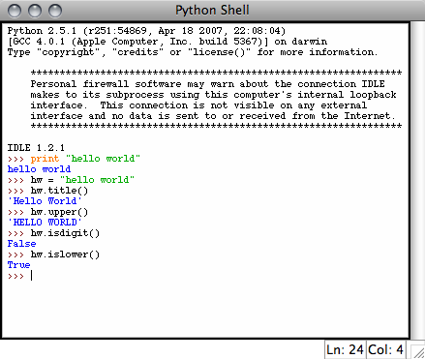
Working with Strings
Assign a string to a variable
Hw= “hello world”
hw.title()
hw.upper()
hw.isdigit()
hw.islower()
hw.isupper()

Slide 10
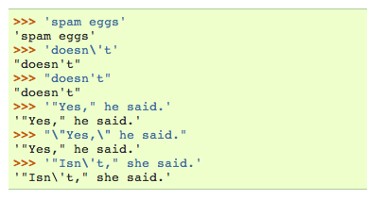
Working with Strings
Examples:

Slide 11
Working with Strings
String literals can span multiple lines in several ways. Continuation lines can be used, with a backslash as the last character on the line indicating that the next line is a logical continuation of the line:
hello = "This is a rather long string containing\n\
several lines of text just as you would do in C.\n\
Note that whitespace at the beginning of the line is\
significant.”
print hello

Slide 12
Working with Strings
Python does not support a character type, to access individual characters we have to view them as “substrings”.
  aString = ‘Hello World!’
  aString[0]
    ‘H’
  aString[1:5]
    ‘ello ‘
  aString[6:]
    ‘World!’

Slide 13
Working with Strings
Memberships:
  ‘bc’ in ‘abcd’
    True
  ‘n’ in ‘abcd’
    False
  ‘nm’ not in ‘abcd’
    True

Slide 14
Concatenation
We can use the concatenation operator + to create new strings from existing ones or from substrings.
  ‘Hello’ + ‘World’
    ‘HelloWorld’
  “Hello” + “ “ + “World”
    ‘Hello World’
  a=“Welcome to our Class”
    b =a[1:3] + ‘ ‘ + a[8]+a[1]+a[5]+a[6]
    What would be the output?

Slide 15
Concatenation
Python allows programmers a simpler way to concatenate adjacent strings, this is not the normal way but it’s a “convenient glitch”
  foo = "Hello" 'World'
  print foo
    ‘HelloWorld’

Slide 16
Receiving Integers from the User
To receive an integer from the user you can use the “input” command.
  >>> x = input (“Give me a number: “)
    Give me a number: 5
  >>> type (x)
    <type ‘int’>

Slide 17
Receiving parameters from the Command Line
To get information into a program, we will typically use the command line.
The command line is the text you enter after the word “python” when you run a program.
import sys
  print "hello, world!"
  print sys.argv[1]
  print sys.argv[2]
The zeroth argument is the name of the program file.
Arguments larger than zero are subsequent elements of the command line.

Slide 18
Receiving parameters from the Command Line
DEMO:
#!/usr/bin/env python
import sys #libreria importada
print "hola mundo voy a recibir algo de la linea de comandos y es: "
print sys.argv[1]
print sys.argv[2]

Slide 19
Receiving parameters from the Command Line
To run the program we do the following:
Assuming its saved as: cline.py
  Python cline.py param1 param2
How could we run it directly?

Slide 20
Executing Python Scripts
To execute a python script you have to do the following:
Insert at the top of the script the following:
  #! /usr/bin/env python
Save the script
Modify permissions
  Chmod 700 myscript.py

Slide 21
Executing Python Scripts
4.- Run the script:
  ./script_name optional_parameters

Slide 22
Receiving parameters from the Command Line
Modify the program cline.py to receive two inputs, number A and Number B and make the program multiply both numbers:

Slide 23
Receiving parameters from the Command Line
Proposed Solution:
  We must convert the input received from the command line to integer.
  To do so we use a built in function or constructor named: int ()
  int (argv[1]) this line will convert the input received as a string to an integer.

Slide 24
Solution
#!/usr/bin/env python
# programa que recibe de la linea de comandos 2 parametros y los multiplica
#hecho con entusiasmo por Ivan Escobar
import sys
print "La multiplicacion de los dos parametros de entrada es: "
a= int(sys.argv[1])
b = int (sys.argv[2])
print a * b

Slide 25
Importing Libraries
Many python functions are only available via “packages” that must be imported.
>>> print log(10)
Traceback (most recent call last):
File "<stdin>", line 1, in ?
NameError: name 'log' is not defined
>>> import math
>>> print math.log(10)
2.30258509299

Slide 26
Receiving input from the User
The function:
raw_input(“Give me a value”)
prints “Give me a value” on the python screen and waits till the user types something (anything), ending with Enter
Warning, it returns a string (sequence of characters), no matter what is given, even a number (‘1’ is not the same as 1, different types)

Slide 27
Working with Math
import math
radiusString = raw_input("Enter the radius of your circle:")
radiusFloat = float(radiusString)
circumference = 2 * math.pi * radiusFloat
area = math.pi * radiusFloat * radiusFloat
print
print "The cirumference of your circle is:",circumference,\
", and the area is:",area

